Slide 1

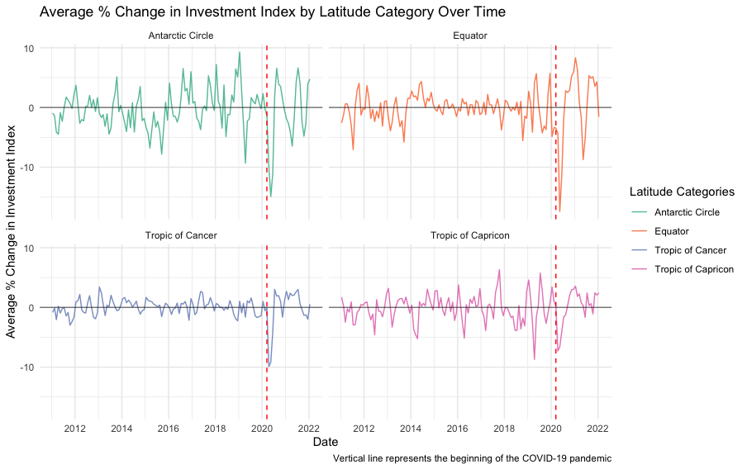
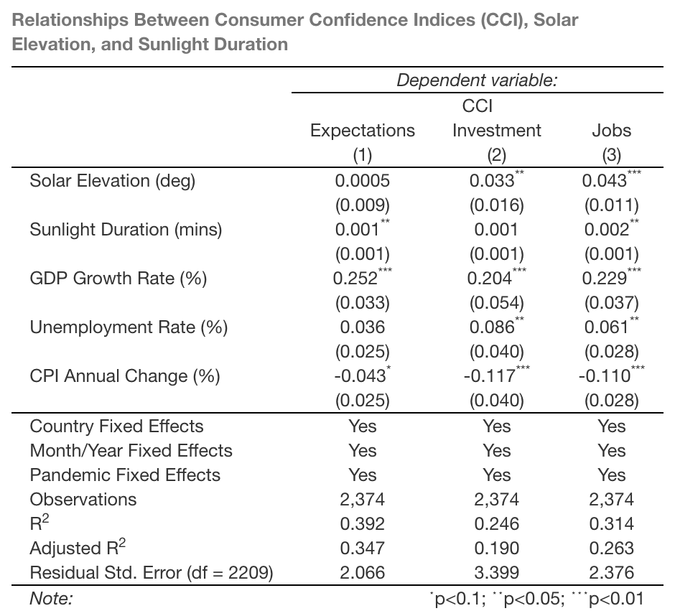
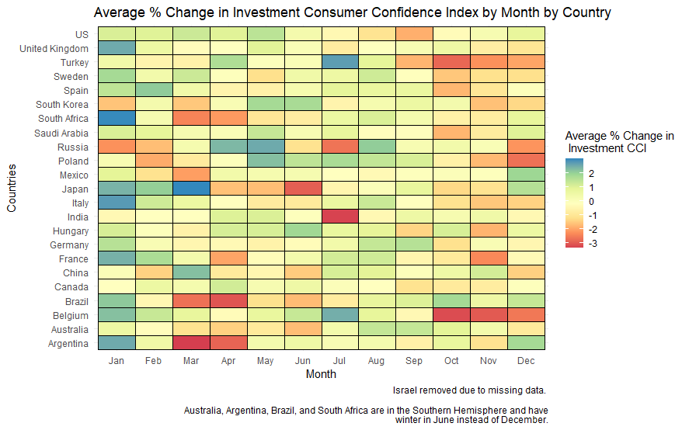
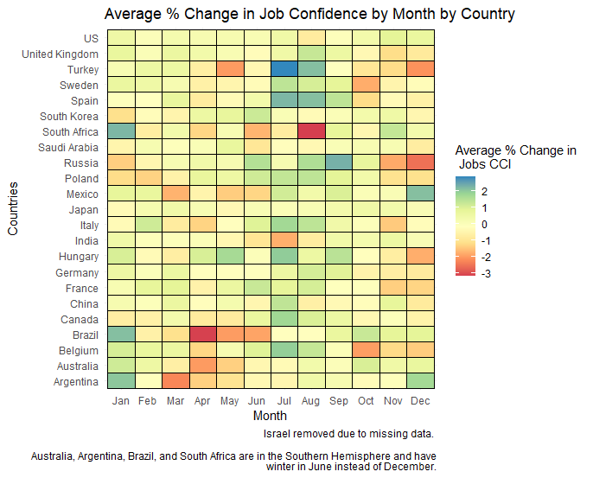
The Association Between Seasonal Affective Disorder
(SAD) and Consumer Confidence
Caleb Henning, Balazs Zelity, Wesleyan University Economics Department, Quantitative Apprenticeship 2022
INTRODUCTION
It has been hypothesized that seasonal variables such as SAD (Lin, 2015; Lo & Wu, 2018) and temperature (Liu et al., 2021) have a negative impact on the economy during the winter months, especially regarding investment behavior. Additionally, some research has been done on the relationship between length of daylight and consumer confidence in Japan (Sekizawa & Konishi, 2021). This research aims to extend the investigation into the relationship between SAD—measured indirectly through the seasonal variables of sunlight duration, solar elevation, and sun declination—and consumer confidence in 24 countries worldwide.
Figure 2. Time-series graph representing the average change in the Investment Consumer Confidence index over time for four different latitude categories
VISUALIZATIONS
Figure 1. This heatmap displays the average change in investment confidence by month for each of the countries in the dataset. It shows a decline in consumer confidence in their personal investments during the winter months, especially in the Northern Hemisphere.
Figure 2. This time-series graph displays the percentage change in investment confidence over time. There is a clear drop in confidence at the start of the COVID-19 pandemic and some evidence of cyclical changes in confidence that correspond with seasonal cycles. Latitude categories represent aggregated values for countries that share similar centroids and similar seasons.
Figure 3. This heatmap displays the average change in job confidence by month for each of the countries in the dataset. It shows an increase in confidence in the job market during the summer months, especially in the Northern Hemisphere.
Table 1. This table shows three of the most significant fixed effects regressions that were run. Control variables included GDP growth rate, unemployment rate, and annual CPI percentage change.
Table 1. Fixed effects regressions for the three most significant relationships between percentage change in consumer confidence and seasonal variables
DISCUSSION
There is a significant negative relationship between consumer confidence and sunlight duration, as shown in Table 1. As the days become longer, consumers generally feel more confident in the economy, especially when looking at the percentage change in Expectations, Investment, and Jobs. Expectations looks at confidence in the future of their local economy and personal financial situation, Investment looks at confidence in personal investments and comfort with making purchases, and Jobs looks at perceptions of job security. Other variables that deal more with confidence in the current state of the economy do not have significant relationships with seasonal variables. Sunlight duration and solar elevation were the most significant predictors of percentage change in consumer confidence.
These results are consistent with findings from Japan that suggested that consumer confidence and asset value expectations peak in the summer months and drop in the winter months (Sekizawa & Konishi, 2021). Visualizations that look at percentage change for each of these variables, such as those in Figure 1 and Figure 3, also support these conclusions, showing declines in consumer confidence in the winter months and slight inclines in consumer confidence in the summer months, especially when looking at Investment and Jobs.
Further research should be done into this topic with specific focus on how consumer perceptions of the future of the stock and job markets at large. Additionally, this research should be repeated with more directly measured SAD variables to confirm this relationship between the seasons and consumer confidence.
Figure 1. Heatmap representing the average percentage change in investment consumer confidence by month
METHODS
The seasonal variables of sunlight duration, solar elevation, and sun declination were calculated using the NOAA’s solar data formulas. Each variable was calculated using the 15th of the month at 12 p.m. as well as each country’s centroid coordinates.
Monthly consumer confidence indices were taken from Ipsos data and the OECD consumer and business confidence indices from March 2010 to January 2022. Ipsos data included five different consumer confidence measures that evaluated consumers’ perceptions of their local economy.
Fixed effects regressions were run on combinations of each seasonal variable and consumer confidence index, controlling for collinearity in seasonal variables. Control variables of GDP growth rate, unemployment rate, and annual change in CPI were also included in the regression models.
REFERENCES
Lin, M.-C. (2015). Seasonal affective disorder and investors’ response to earnings news—ScienceDirect. International Review of Financial Analysis, 42, 211–221. https://doi.org/10.1016/j.irfa.2015.07.003
Liu, H., Zhang, W., Zhang, X., & Liu, J. (2021). Temperature and trading behaviours. International Review of Financial Analysis, 78, 101890. https://doi.org/10.1016/j.irfa.2021.101890
Lo, K., & Wu, S. S. (2018). The Impact of Seasonal Affective Disorder on Financial Analysts. The Accounting Review, 93(4), 309–333.
Sekizawa, Y., & Konishi, Y. (2021). Are consumer confidence and asset value expectations positively associated with length of daylight?: An exploration of psychological mediators between length of daylight and seasonal asset price transitions. PLOS ONE, 16(1). https://doi.org/10.1371/journal.pone.0245520
DATA SOURCES
1. Ipsos Consumer Confidence Indices
2. OECD Consumer Confidence and Business Confidence Indices
3. IMF International Financial Statistics
4. Gavin R World Countries Centroids Coordinates
Figure 3. Heatmap representing the average percentage change in job confidence by month

